Slide 1
Object Detection Customisation Website --Process and Reflection
By Yichen
Link: https://github.com/GitHub-OfficialAccount/aiweb

Slide 2
Why this web app
Even though Artificial Intelligence is becoming more and more prevalent, many people do not know what AI is and how it works besides the fact that they are smart and can act like a human.
Hence, I decided to implement a simple AI web app that allows anyone to experience AI and even use it to solve problems in the world.

Slide 3
Core steps of development
Working website that allows basic form submission, image and file handling, and webpage redirection.
Working codes that perform image training using a given detectron2 object detection model.
Combine the website and the image training process.
Improve user interface and add static features to reduce server processes.

Slide 4
Challenge 1
While web development is not new to me, it is my first time building a website using Django (all my previous websites were built using Flask). There were nuanced differences in similar parts of Django and Flask. For example, Django’s way of getting post response is request.POST (captalised), while Flask’s is request.form. These minor differences led to confusion and I had to search online to resolve those issues.

Slide 5
Challenge 2
Object detection was a completely new topic to me. In the process of training the model, I encountered many errors that I had never seen before. Some errors were very confusing and did not seem to apply in the context. For instance, I received an IndexError when I trained the model with images featuring red blood cells and platelets. It took me quite a while to realize that the error was due to the mismatch of the NUM_CLASS attribute (value=1) and the number of items (2 different cells, i.e. value=2) to be detected in my dataset.

Slide 6
Challenge 3
The most challenging part of the development is combining the Django website with the detectron2 program. Due to inadequate planning of the location of codes, I had to perform numerous imports from one script to another and combine messy system paths to ensure accurate OS paths for uploading and reading files. This error was significantly worsened by Visual Studio Code’s default OS directory which differs from normal python scripts’ that Django websites adopt. To reduce code redundancy and improve tidiness, I made a new script that handles most imports before importing the imported functions and attributes again to my main server script.

Slide 7
Strength 1
This object detection model is capable on training on databases that contain more than 1 object. i.e. You can have 2 or more different labels.
However, the default NUM_CLASS value is 1, which means there is only 1 object to detect.

Slide 8


Strength 2
The model can be used to carry out video detection, creating more possibilities for users to explore object detection.

Slide 9
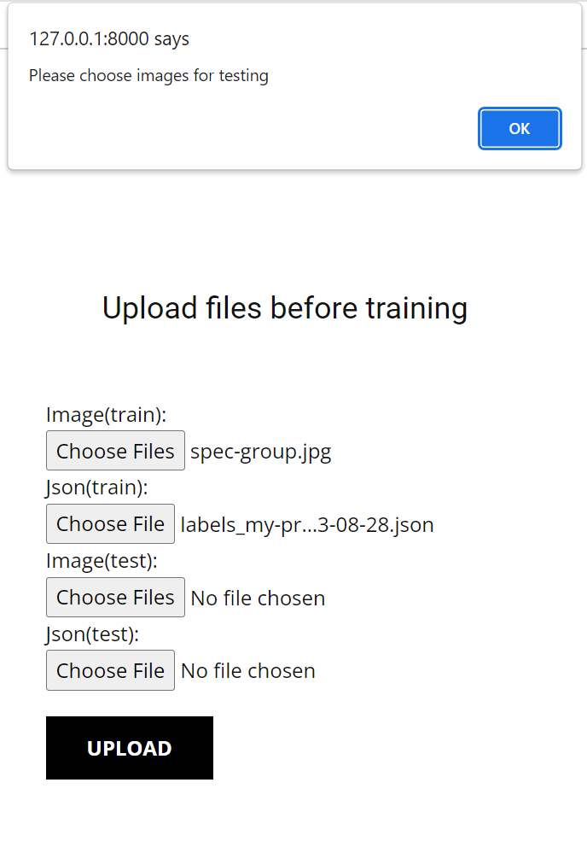
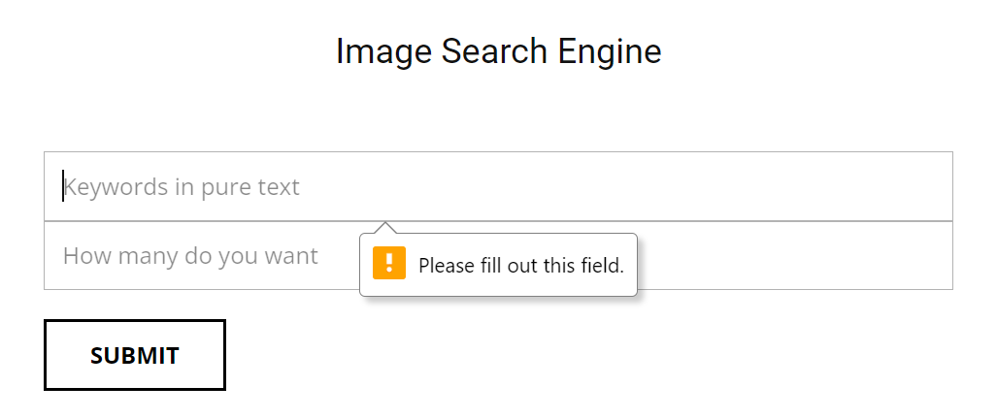
Strength 3
Reliable static features to reduce the server’s workload and prompt error messages to perform input validation.

Slide 10
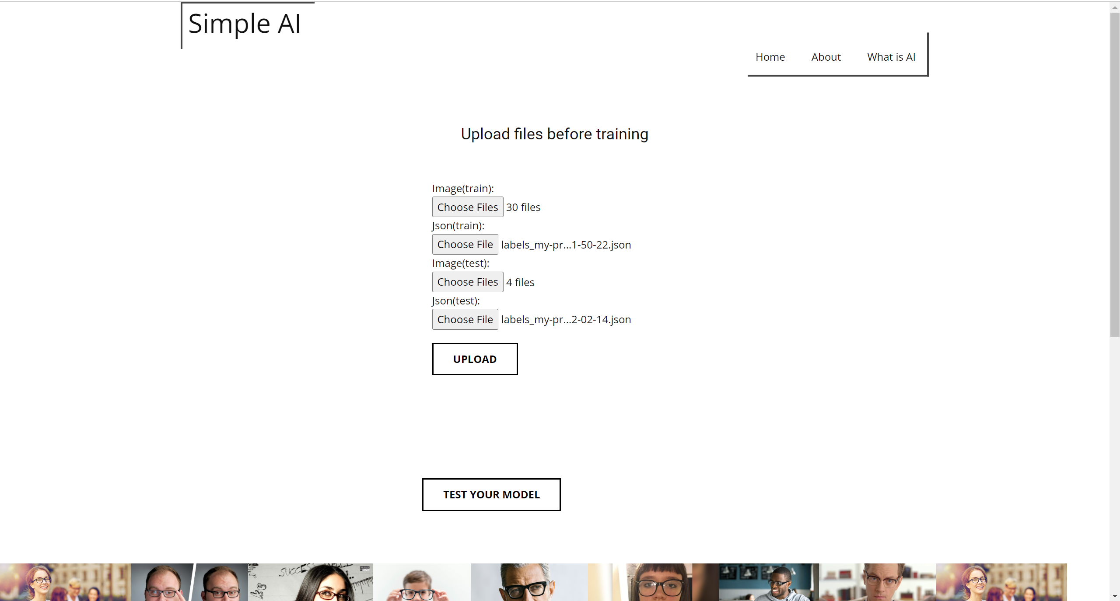
Upon selecting images, the static feature of the webpage will display the selected images to alert the user.

Slide 11
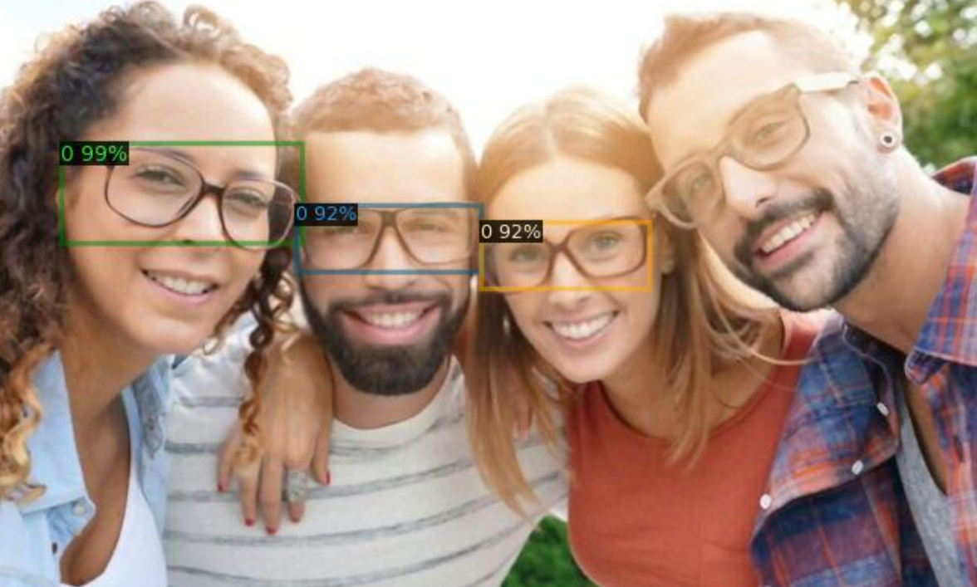
Drawback 1
For small datasets(30 images for training and 4 images for testing as shown in the user manual), the trained model is less accurate as it is unable to capture objects at various angles or of various shapes.
While larger datasets would clearly lead to more accurate and precise results, it would also mean a heavier workload on the user as well as the server.
Hence, users have to balance work load, accuracy and time span of the training process.
Users may also use public resources for training.

Slide 12
Drawback 2
For heavy processes (e.g. Training the model with annotated images), the website loading is very slow.
The website should rather be able to constantly update system processes to improve user experience e.g. showing the expected time taken of training and the training progress.

Slide 13
Drawback 3
While the final trained model can be used to detect videos, it is difficult to perform real time video detection in the web.
Perhaps a .exe program could be built to allow users to use the trained model locally.

